Slide 1

VYSYA COLLEGE OF ARTS AND SCIENCE
(AFFILIATED TO PERIYAR UNIVERSITY)
SALEM – 636 103
A MINI PROJECT
On
DYNAMIC SEATING ALLOCATION SYSTEM
BACHELOR OF COMPUTER APPLICATIONS
In
DEPARTMENT OF COMPUTER SCIENCE
BY
SURESH G
[C21UG131CAP041]
Under the Guidance of
Mr. S. NATARAJAN
[Asst.Prof.in Computer Science]
BATCH 2021-24

Slide 2
01
SYNOPSIS
02
EXISTING SYSTEM
03
PROPOSED SYSTEM
04
MODULES
CONTENTS
05
DESCRIPTION
06
FRONTEND & BACKEND
07
DATA FLOW DIAGRAM
08
OUTPUT
09
CONCLUSION
10
FUTURE ENHANCEMENT

Slide 3
SYNOPSIS
The Dynamic Seating Allocation System is a tool to help college administrators organize where students sit in classrooms during examination times. By automating this task, it saves time for administrators and ensures students are seated optimally. It's designed with user-friendly interfaces to make it easy to us. It's made to be really easy to use, with simple screens and buttons that anyone can understand.

Slide 4
EXISTING SYSTEM
Currently, our college uses Excel along with VBA macros for seating arrangements. This means we enter student info, room details, and seating preferences into Excel sheets. Then, VBA macros help automate some parts of the seating process. Operating and maintaining the existing system requires a certain level of technical expertise, particularly in VBA programming.

Slide 5
PROPOSED SYSTEM
The proposed system is a modern software made for colleges to manage seating arrangements. It's easy to use and meant to improve how colleges handle seating. Instead of the old way, this new system is much simpler and with extra features. It includes a simple interface where you can enter information easily. Plus, it creates seating plans in PDF format, so you can view and share them easily.

Slide 6
MODULES
LOGIN PAGE
SIGNUP PAGE
HOME PAGE
GENERATE EXCEL
OUTPUT
GENERATE
PDF OUTPUT
GENERATE
STUDENT DETAILS

Slide 7
LOGIN PAGE
Administrators need to enter their username and password in the designated fields provided on the screen. Once they've filled in their details, they can click the "Sign in" button.
If administrators make a mistake and enter the wrong username or password, the system will show them an error message to let them know and ask them to try again with the correct details.

Slide 8
SIGNUP PAGE
It provides a user-friendly interface where individuals can input their desired username and password.
Valid user credentials are securely stored in a text file for future authentication. Once the registration process is successfully completed, users receive confirmation through a custom information dialog.

Slide 9
HOME PAGE
It offers a user-friendly interface where administrators can define various parameters related to each exam room, such as room number, capacity, and seating arrangement.
Administrators can input details such as the room number and the maximum capacity of students allowed in each room.
Additionally, they can specify the layout of the seating arrangement, including the number of rows and columns in the room.

Slide 10
GENERATE EXCEL OUTPUT
This module takes the allocated seats data and organizes it into an Excel file format (.xlsx), making it easy to manage and distribute
The process begins by gathering the allocated seating information from the system's Excel Sheet

Slide 11
GENERATE PDF OUTPUT
This module transforms the allocated seating data into PDF documents, which are easy to distribute and view across different devices.
Each seat is labeled with the student's unique identifier or registration number to indicate their allocated position.
The PDF output may include other relevant details such as the room number, exam date, and supervisor instructions.

Slide 12
GENERATE STUDENT DETAILS
This module generates comprehensive reports detailing the distribution of students across various departments and rooms. It provides a breakdown of the number of students from each department assigned to each room, spanning from Room 1 to Room N.
Additionally, the module includes the total count of students allocated to each room, offering administrators a clear overview of student occupancy.

Slide 13
FRONTEND & BACKEND
FRONTEND
BACKEND
PYQT5
EXCEL SHEET
FRONTEND
BACKEND
TKINDER,DATAFRAMES
PYTHON

Slide 14
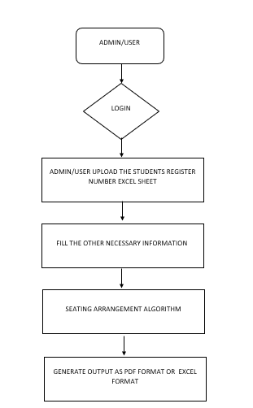
DATAFLOW DIAGRAM

Slide 15
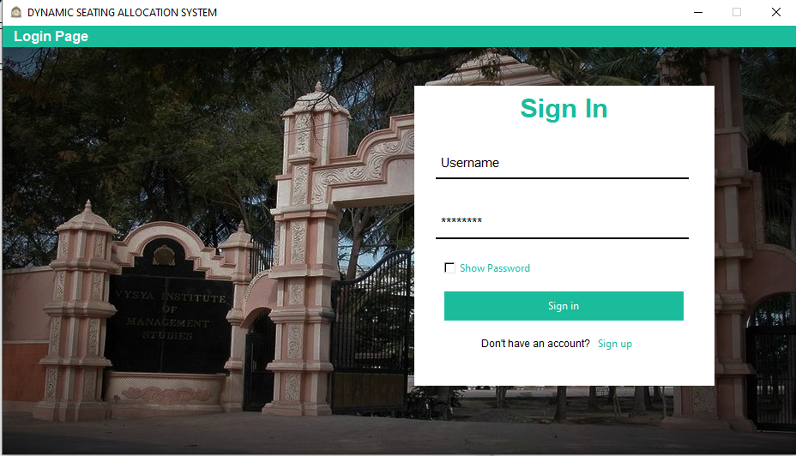
OUTPUT WINDOW
LOGIN PAGE

Slide 16
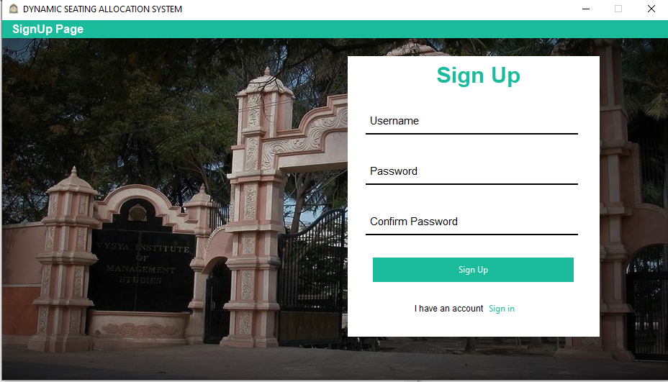
OUTPUT WINDOW
SIGNUP
PAGE

Slide 17
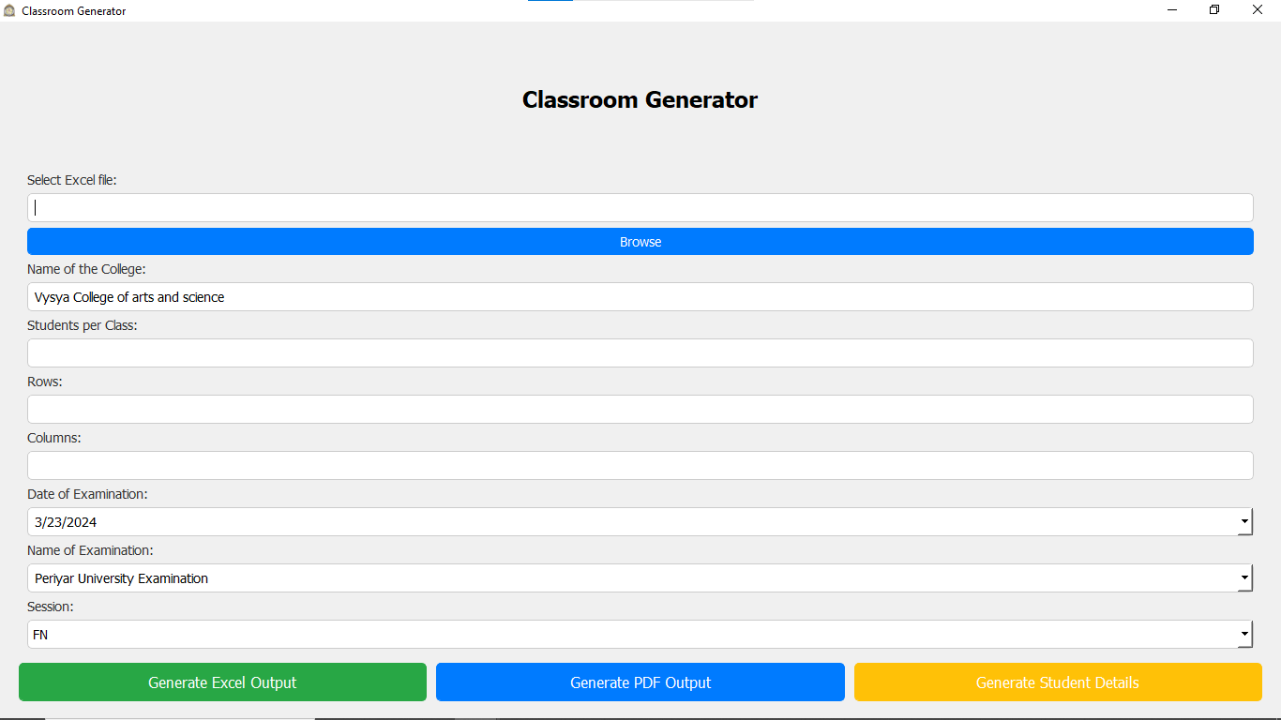
OUTPUT WINDOW
HOME PAGE

Slide 18
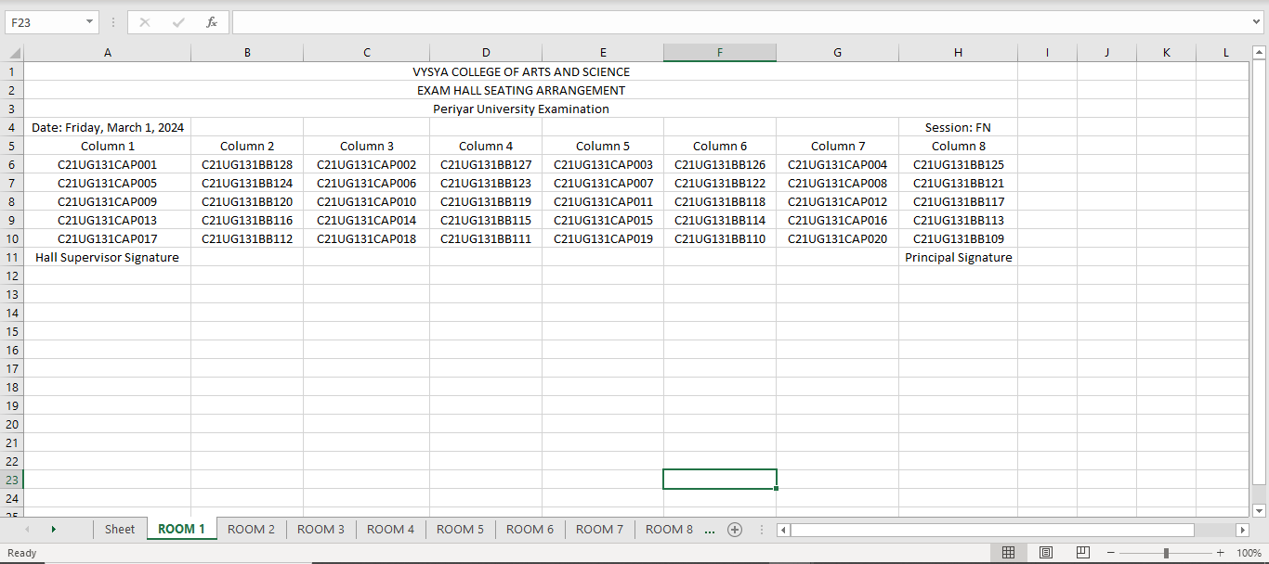
OUTPUT WINDOW
EXCEL OUTPUT
ROOM 1

Slide 19
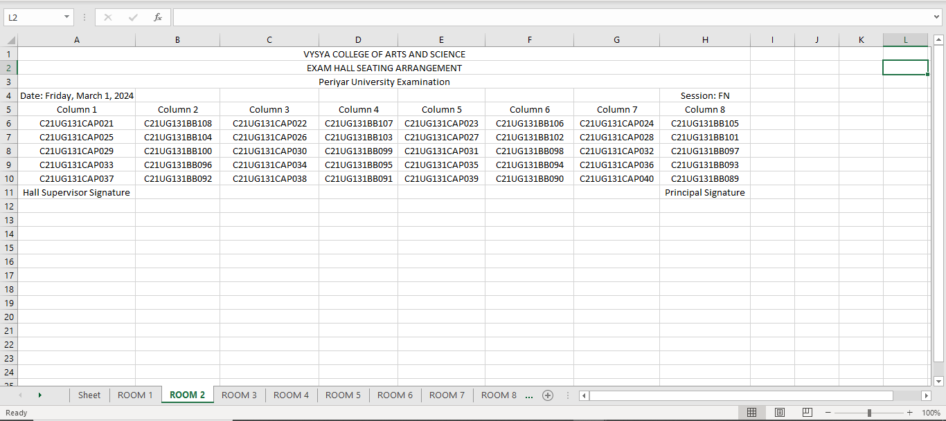
OUTPUT WINDOW
EXCEL OUTPUT
ROOM 2

Slide 20
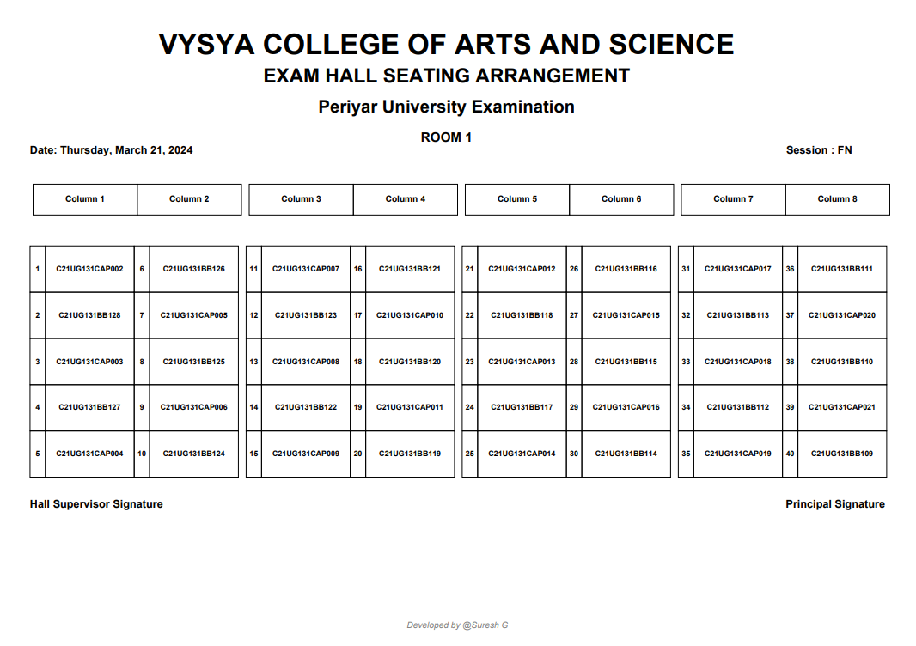
OUTPUT WINDOW
PDF
OUTPUT
ROOM 1

Slide 21

OUTPUT WINDOW
PDF
OUTPUT
ROOM 2

Slide 22
CONCLUSION
The DYNAMIC SEATING ALLOCATION SYSTEM project was a journey of understanding, planning, and implementation to meet the needs of college administrators effectively. Through meticulous analysis, thoughtful design, and thorough testing, we ensured that the system met its objectives of simplifying exam hall management.

Slide 23
FUTURE ENHANCEMENT
For future improvements, we can make the DYNAMIC SEATING ALLOCATION SYSTEM better in a few ways. One idea is exploring features such as dynamic seating allocation algorithms to optimize space utilization and accommodate varying exam schedules efficiently
Moreover, integrating a notification system to alert students about their allocated seats and exam details in real-time could enhance user experience and reduce administrative workload

Slide 24
Thank You

